Slide 1

How Did COVID-19 Change AQIs in the US?
EPA AQI DATA ANALYSIS
GWU Bootcamp Project 1
Trent Little
Jessica White
Matthew Rose
Edouard Dione
Yusra Kaupplia

Slide 2
Hypothesis
After COVID-19 shutdown occurred, what happened to the Air Quality Index (AQI) in the 5 states below during March 2019 to August 2020?
Massachusetts
District of Columbia
New York
Illinois
California
Notes:
We used states that had cities recorded as having the worst traffic areas in the United States according to Business Insider.
We also wanted to pick states that would have been impacted by COVID-19 related government shutdowns.
Finally, we wanted states that used both a mix of public and private transportation methods.

Slide 3
What are we asking?
What is the Air Quality Index?
What parameters contributed more to variable changes in the AQI during this time period?
Do all the states trend in the same way over the time frame?
What did we observe?

Slide 4
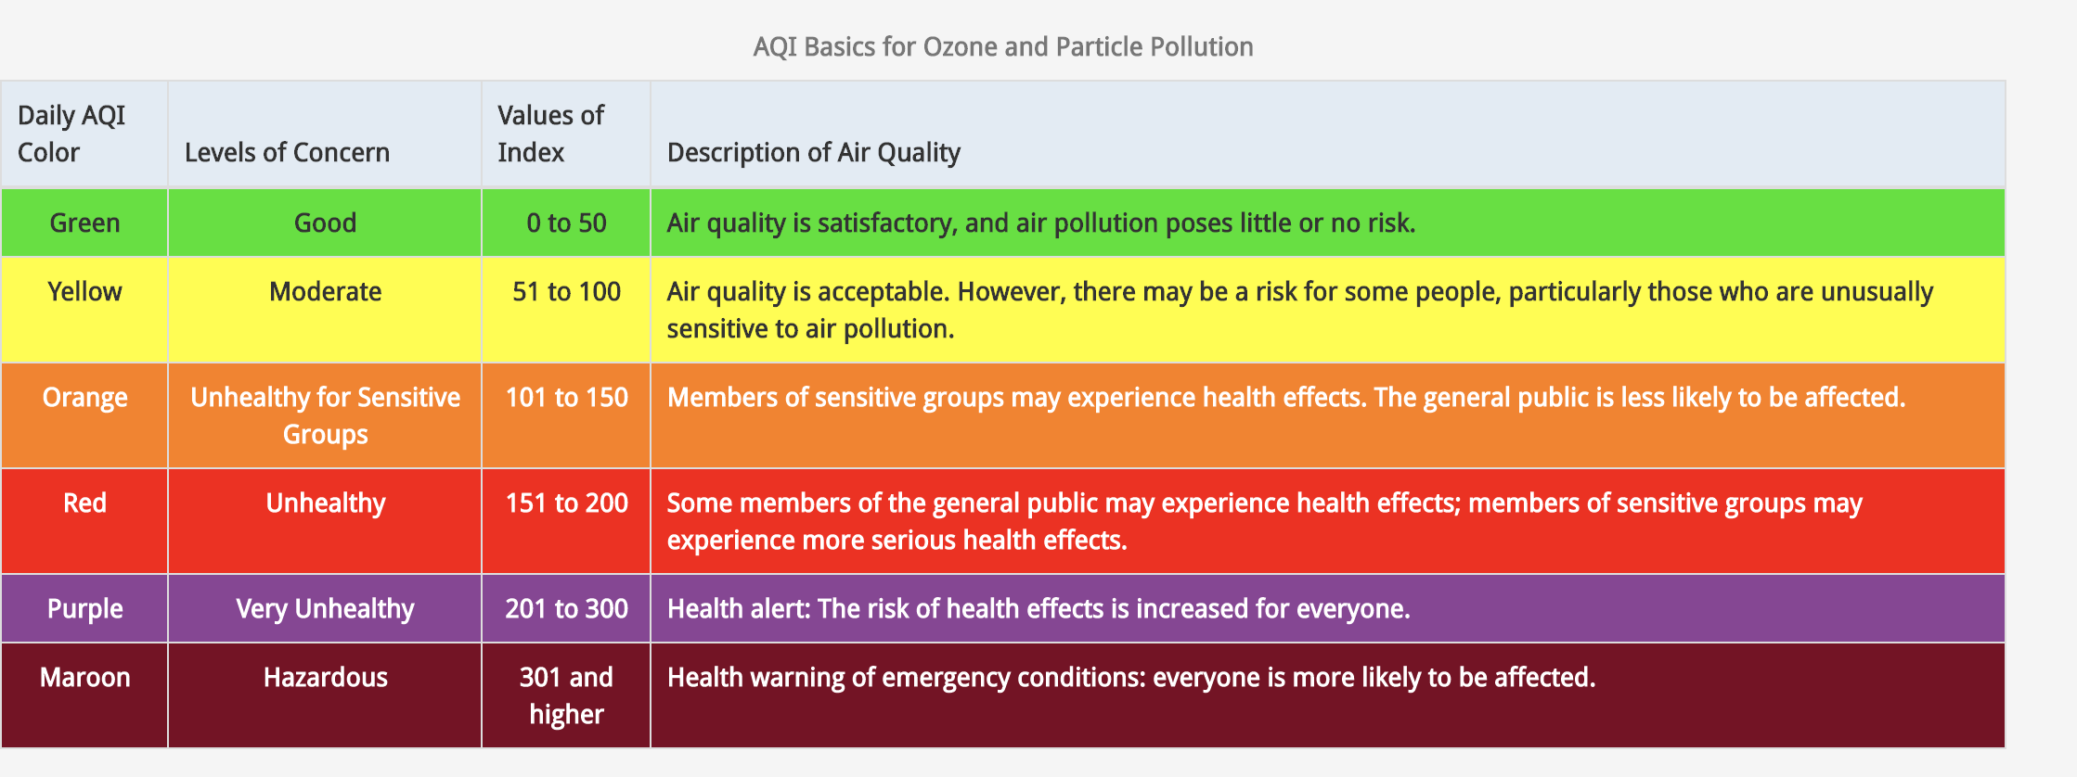
Air Quality Index
AQI is the EPA’s index for reporting air quality.
AQIs are tracked for 5 major pollutants
- Carbon Monoxide
Sulfur Dioxide
Nitrogen Dioxide
- Particle Pollution (PM 2.5 and PM 10)
- Ground-Level Ozone

Slide 5
Carbon Monoxide AQI (Illinois vs Massachusetts)
Notes:
Our beginning and end dates for 2019 data were run January 01 2019 to December 12, 2019
Our beginning and end dates for 2020 data were run January 01 2020 to August 01, 2020
Demonstrates how the carbon monoxide data was smaller in AQI level reported
At first, we used Carbon Monoxide as our parameter when pulling data. The AQIs for this parameter were low in all states and did not tell a good story of the actual AQI in those states.
We then ran the data using the Particle Pollution and Ground Level Ozone parameters, this resulted in larger sets of data over larger ranges of time.
We cleaned the data additionally by singling out the sample duration column in our data frame. Every parameter resulted in various AQI reports per sample duration
Comments
Elected not to replace NaN with 0 since this will ultimately skew the average.
Hawaii data was small and limited
Limited reporting – on some of the graphs you will notice that there are gaps in the data and the lines are not continuous. A lot of this missed data reporting appears to occurring right before/around COVID 19 time fra,e
Would have resulted in a more substantial result in the variance if we had pulled longer time frames of data, was this just a fluke or did this trend far lower than what the regression line would have shown?

Slide 6
Ground Level Ozone AQI (Illinois vs Massachusetts)
Notes:
Demonstrates how the ground level ozone data was larger number than carbon monoxide

Slide 7
Particle Pollution PM 2.5 AQI (Illinois vs Massachusetts)

Slide 8
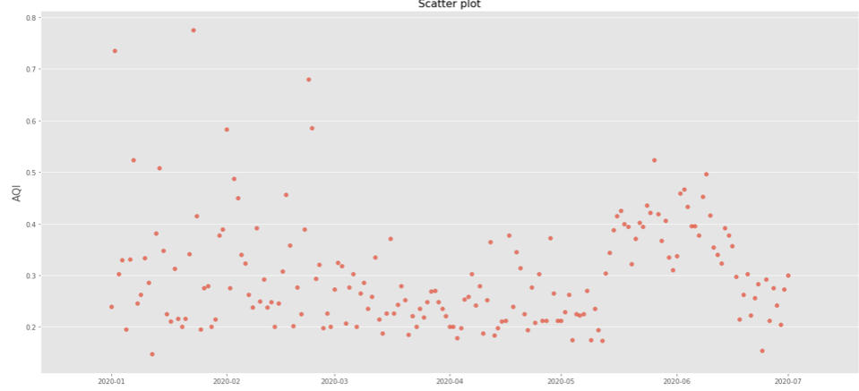
2020 Data for Washington, DC

Slide 9
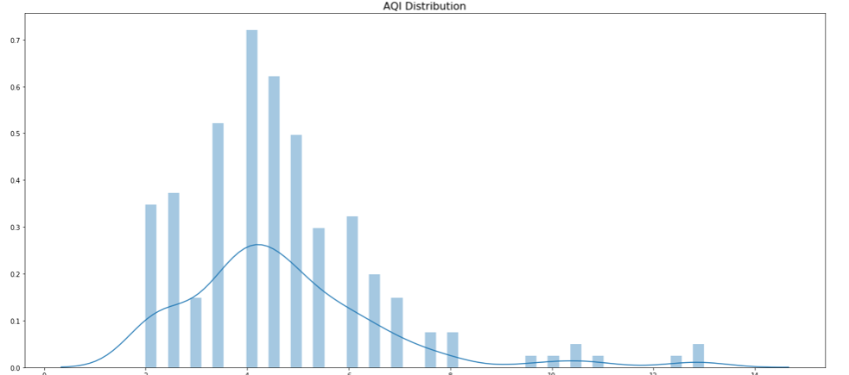
2020 Data for Washington, DC

Slide 10
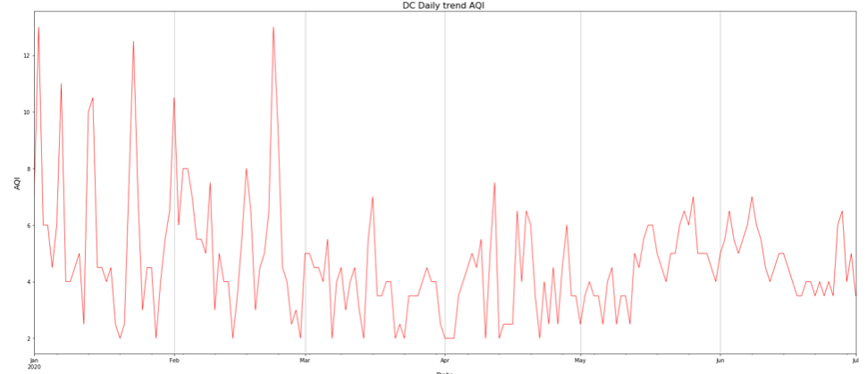
2020 Data for Washington, DC
Notes:
How the parameters trended across DC.

Slide 11
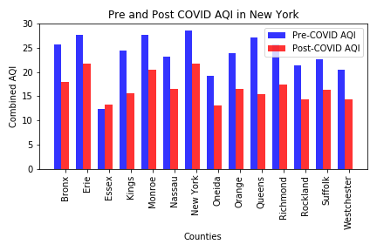
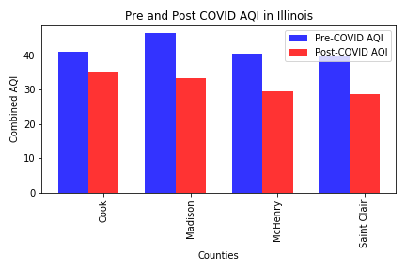
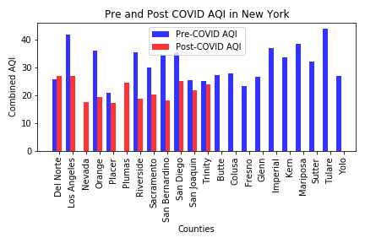
AQI Pre and Post COVID by County for New York, Illinois, and California
Notes:
How the parameters trended by county (Bar graph) Per Month

Slide 12
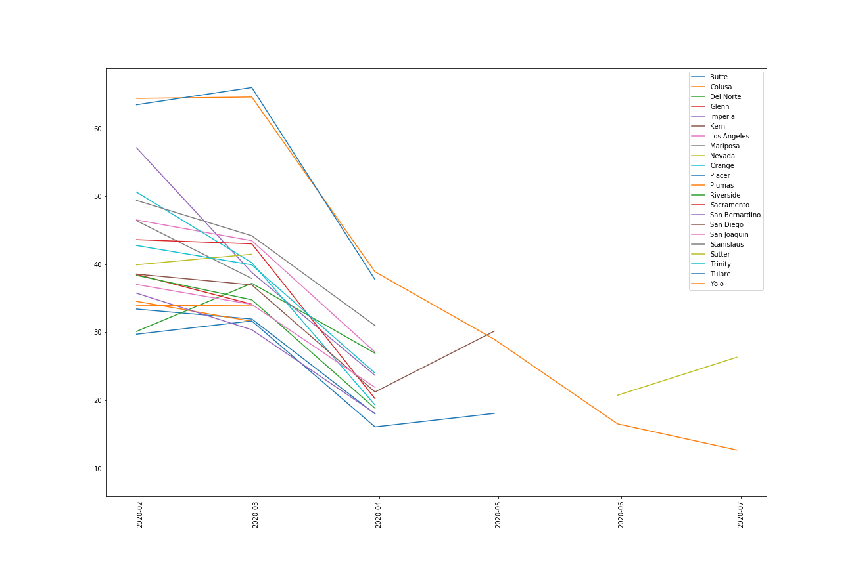
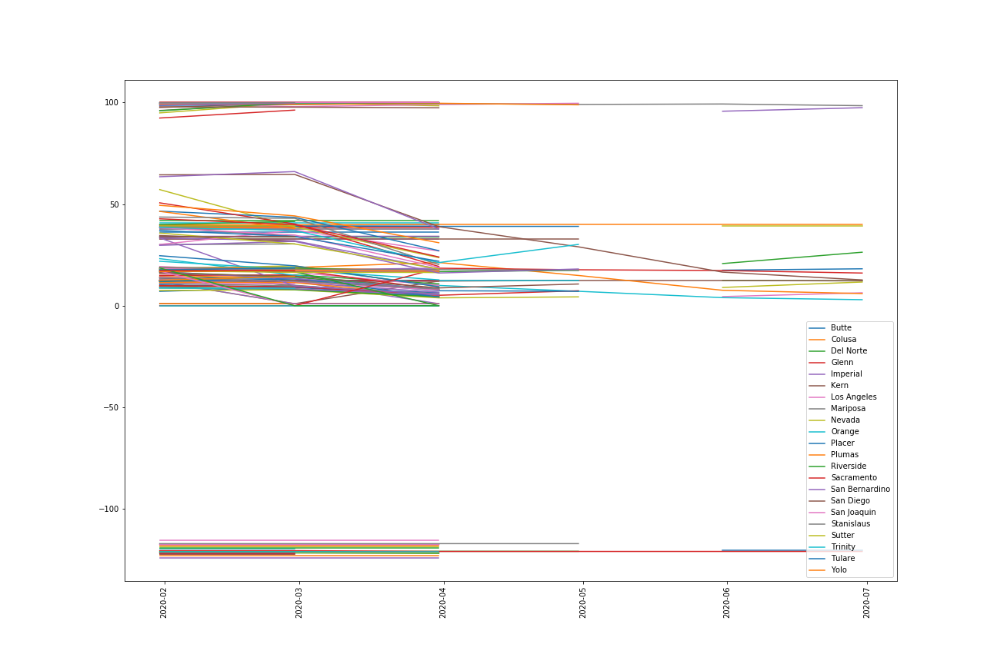
California AQI Data Trends

Slide 13
Conclusion
The two parameters measured for AQI that are most meaningful are PM 2.5 and Ground Level Ozone
Counties near major metropolitan cities resulted in the sharpest drop off during COVID-19 Shutdown
Visually there is a change in the data, but results are inconclusive. Data needs to be run on a longer time frame to show a more definitive result.
Overall the parameters trended in similar directions across the 5 states we tested.
Notes:
Jessica and Yusra concluded that although the shutdown occurred, there wasn’t that drastic of change.
More data needed to be viewed on longer time frame
Queens, Cook, (Mass County), went down during shut down, more densely populated counties had a more variable change on the AQI
Carbon Monoxide and the Ozone have the same trends occurring in March in Washington DC

Slide 14
Sources
https://www.airnow.gov/aqi/aqi-basics/
https://aqs.epa.gov/aqsweb/documents/data_api.html#signup
https://www.businessinsider.com/us-cities-most-traffic-2019-2020-3

